Slide 1
The F# Computation Expression Zoo
Tomas Petricek, University of Cambridge
Examples: http://tryjoinads.org/computations
Get in touch: @tomaspetricek | tomas@tomasp.net

Slide 2
software stacks trainings teaching F# user groups snippets mac and linux cross-platform tutorials
F# Software Foundation
F# community open-source MonoDevelop
http://www.fsharp.org
contributions research support consultancy Emacs and vim

Slide 3
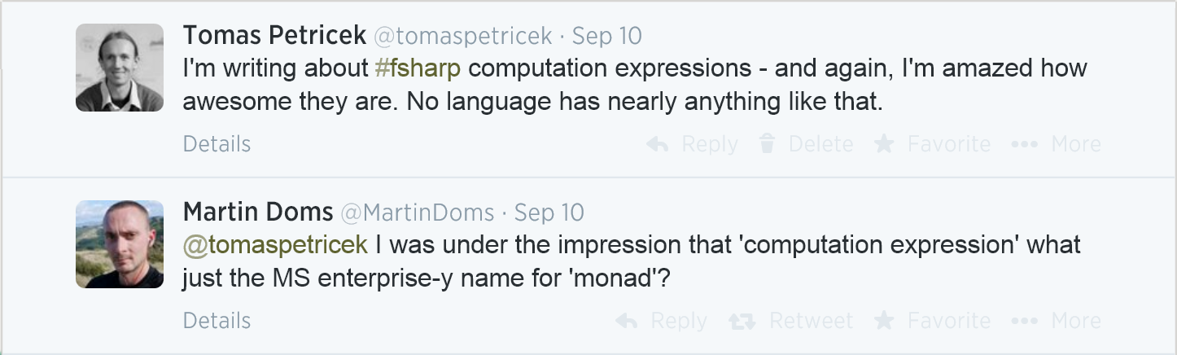
What are computation expressions?

Slide 4
Syntax for non-standard computations Haskell do, Python generators, C# async

Slide 5
twiceState :: State Integer ()
twiceState = do
x ← get
set (x * 2)
do
←
async Task<string> GetLength(string url) {
var html = await DownloadAsync(url);
return html.Length;
}
async
await
return
def duplicate(inputs):
for number in inputs:
yield number
yield number * 10
for
yield
yield

Slide 6
Language Feature
Nice syntax (await, yield)
Just one use case
General Purpose
Many different uses
May not be the best fit
Computation Expressions
Reusable but flexible syntax
Library author can decide!

Slide 7
Computation expressions Asynchronous workflows

Slide 8
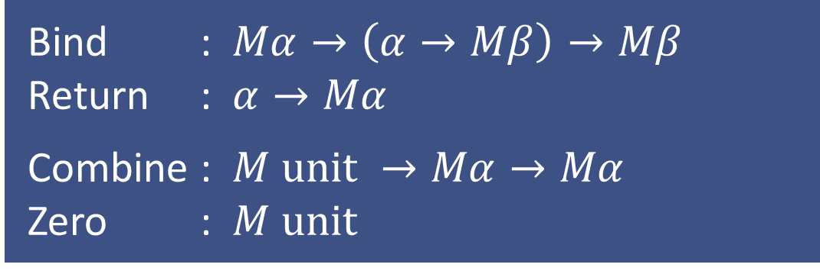
Monadic computations
Bind : $Mα→\left(α→Mβ\right)→Mβ$
Return : $α→Mα$
Combine : $M unit →Mα→Mα$
Zero : $M unit$
Combine means sequencing
More operations enable more syntax (for, while, exception handling)

Slide 9
Syntax for additive computations Parsers and sequence expressions

Slide 10
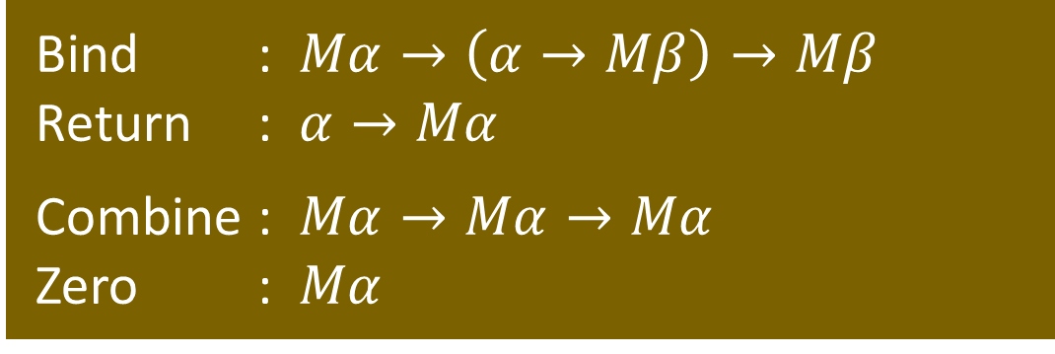
Additive computations
Bind : $Mα→\left(α→Mβ\right)→Mβ$
Return : $α→Mα$
Combine : $Mα→Mα→Mα$
Zero : $Mα$
Monoid structure: MonadPlus or MonadOr
Get a nice syntax if you have them! Choose the right one (yield vs. return)

Slide 11
Composed computations Using asynchronous sequences

Slide 12
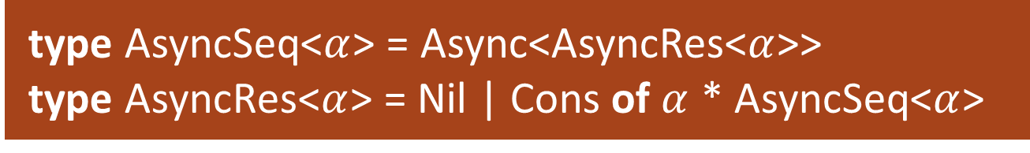

Composed computations
type AsyncSeq<$α$> = Async<AsyncRes<$α$>>
type AsyncRes<$α$> = Nil | Cons of $α$ * AsyncSeq<$α$>
Syntax for monad transformers!
Let library author choose the notation (define For, Bind, Yield, Return operations)
For : $AS α→\left(α→AS β\right)→AS β$
Bind : $A α→\left(α→AS β\right)→AS β$

Slide 13
Summary Why computation expressions?

Slide 14
What can you express?

Slide 15
Syntax matters!
Reuse standard keywords Let library author decide
Examples & source: http://tryjoinads.org/computations
Paper: http://tomasp.net/academic/papers/computation-zoo
Get in touch: @tomaspetricek | tomas@tomasp.net

